Slide 1

RuRec
Сохрани Матушку-Землю
Save Mother-Earth today
The first Slavic eco app

Slide 2
Story 1
User can find the closest recycle point
User should be logged in and viewing home page
User clicks Bottom “find the closest location for recycling”
Pop-up appears “Permission for geo-position”
User clicks bottom “permission for geo-position”
User sees the map with recycling locations and his location
The rank of how close the location and details of what they recycle

Slide 3





RuRec
Login
signup
calculator
Saved trees
MAP
Russia Recycling.
Save Mother-Earth today
The first Slavic eco app
Recycling is cool and blabla and some text about recycling. Interesting and cool.
Find closest location for recycle

Slide 4
RuRec
Login
signup
calculator
Saved trees
MAP
Find closest location for recycle
Please, share your location
CITY
Street
house
index
Accept
decline

Slide 5
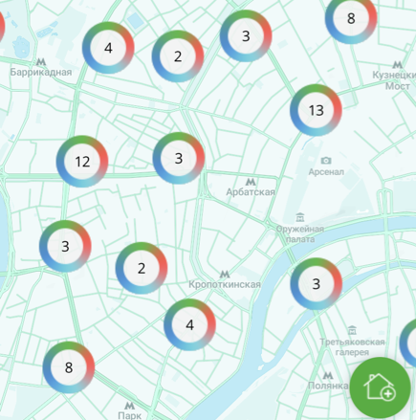
RuRec
Login
signup
calculator
Saved trees
MAP
recycle

Slide 6
Story 2
User can calculate the money value of his waste
User from any page sees menu and he can click on calculator bottom
User viewing calculator page and see:
Textboxes for numbers of waste
Dropdown menu for measurement (bottles, gr etc) and type of waste
Conversion to rubles
Total sums of waste and money
User can enter his numbers in textboxes and choose measurement from dropdown menu.
User clicks bottom “Enter” and receives conversion his waste to money

Slide 7
RuRec
Login
signup
calculator
Saved trees
MAP
Calculate your waste
type
measurement
amount
enter
clear
results
1 kg paper
19 rub

Slide 8
Story 3
After recycling trash user puts his numbers and they convert into percentage of how much mother Russia he saved
User from any page sees menu and he can click on “Saved trees” bottom
Viewing Saved trees page, User logs in all his waste in textbox and choose measurement (bottles, gr etc) and type of waste from dropdown menu
User clicks bottom “Enter” and receives conversion his waste to saved trees
Under textbox user can see his rating among all users and his level of saving Russia

Slide 9

RuRec
Login
signup
calculator
Saved trees
MAP
type
measurement
amount
Save earth
clear
Saved mother-earth
User | Rating | Waste | Saved
19
1 kg
2
iVAN

Slide 10
Story 4
User can invite friends and compare his results of recycle with them
User has personal page where he sees:
His personal data: name,
User information: login and password
Address
Total recycled waste
Rating
Referral code
User clicks bottom “Share” and can send his referral code to his friends vie email
User can click bottom “Compare results” and will be transferred to “Saved trees” page where he sees current his ratings and his friends

Slide 11
RuRec
Login
signup
calculator
Saved trees
MAP
login
Ivan_recycle
password
Qwerty123
name
Ivanov Ivan
address
Moscow, Red square, 1
Referral
code
friends1
rating
19
share
Compare results

